Slide 1
HPE OSS Performance Management
JS & Neo4J
Zhigang Yan
Feb 21st, 2016
Notes:
This is a sample Title Slide with Picture ideal for including a dark picture with a brief title and subtitle.
A selection of pre-approved title slides are available in the HPE Title Slide Library. The location of the library will be communicated later.
To insert a slide with a different picture from the HPE Title Slide Library:
Open the file HPE_16x9_Title_Slide_Library.pptx
From the Slide thumbnails pane, select the slide with the picture you would like to use in your presentation and click Copy (Ctrl+C)
Open a copy of the new HPE 16x9 template (Standard or Events) or your current presentation
In the Slide thumbnails pane, click Paste (Ctrl+V)
A Paste Options clipboard icon will appear. Click the icon and select Keep Source Formatting. (Ctrl+K)

Slide 2
General Ideas
This is a light but extendible solution of performance management.
In the solution, there are 3 main parts
OSSP Server (data collection)
OSSP console (control GUI in UOC)
OSSP report packs (performance reports and dashboards in UOC or other report platforms).
The solution bases on Neo4J database, which provides high performance on massive data.
In the prototype all modules are developed in JavaScript (NodeJS & AngularJS), while customized collectors can be developed in JAVA or Scala.
The control GUI is develop on HPE UOC framework.
Most function modules work independently, they all provide REST APIs for CONTROL and MONITOR.
Collector able to collect performance data ( and log files) from NE, EMS, Application via different protocols.
* Only raw counters are stored in the Neo4J, all calculations are runtime.

Slide 3
Architecture – Function View
GUI
KPI/Threshold Management
Collector Monitor and Management
Model Designer
CORE
Definitions:
Model, KPI, Threshold
Data:
Raw counters
KPI Engine
Threshold Engine(Condition/
Action)
NEO4J
JOB Management
Achieve
Collectors
SNMP Collector
CSV Collector
more Collectors

Slide 4

Architecture – Deploy view
Neo4J Cluster
GUI (UOC) Server
Writer Master
Read Slaves
Collector Servers
MPM Core Server

Slide 5
Architecture – Service View (prototype)
Web GUI Client
KPI Manage Widgets
Collector Manage Widget
Threshold Manage Widget
Model Designer
REST
Web GUI Server
MPM Plugin
REST
REST
KPI Engine
Threshold Engine(Condition/
Action)
NEO4J
REST
JOB Management
Achieve
SNMP Collector
Standard CSV Collector
Not in the prototype

Slide 6
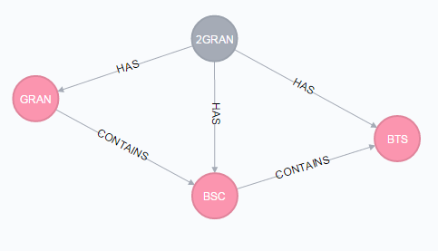
Modelling
To define the model is the first step to use this system. All counters or KPIs must belong to an OBJECT. Model contains objects and relationships. The calculation, propagation, aggregation are based on the model.
The models are group by domains. For example, 2G RAN, IT … In the system domain ID is unique and the id of object in one domain is unique.
To build the model the best way is provide a visualize portal, like NFVD template designer.
The second way is to define the model in a JSON file and use a collector to inject it into the DB.
To update a model, especially to remove an object is ‘dangerous’ in an online system.
Granularity is a special object
{ "domain":"2GRAN", "elements":[ {"id":"GRAN","name":"GRAN","desc":""}, {"id":"BSC","name":"BSC","desc":""}, {"id":"BTS","name":"BTS","desc":""} ], "relationships":[ {"parent_id":"GRAN","child_id":"BSC","type":"CONTAINS"}, {"parent_id":"BSC","child_id":"BTS","type":"CONTAINS"} ] },

Slide 7
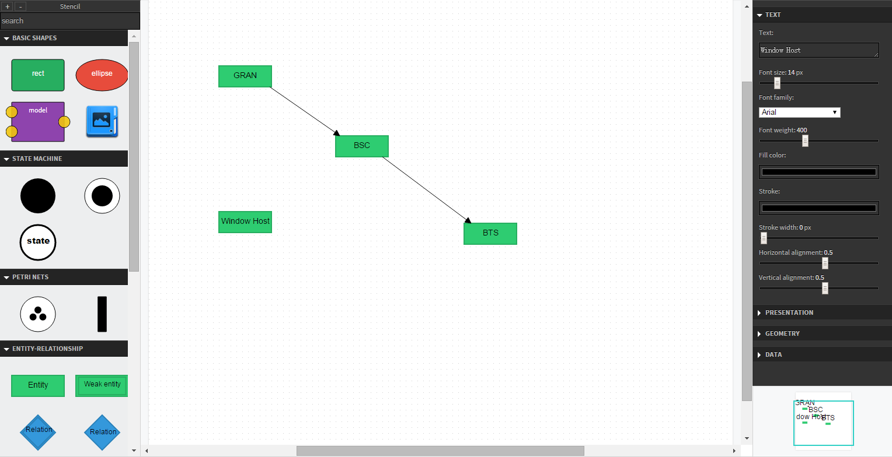
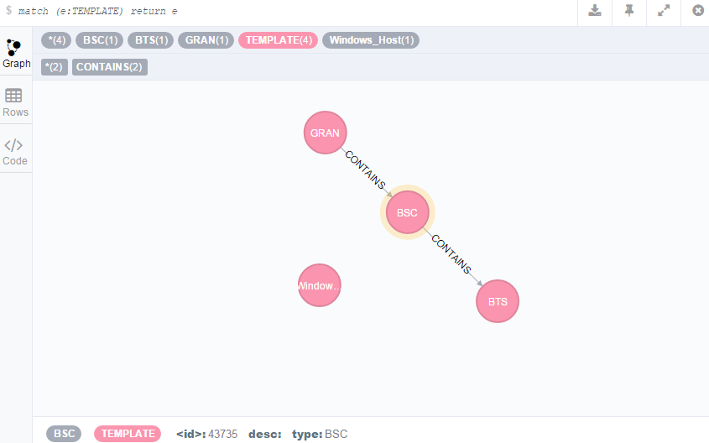
Design Model
Model Designer
A visualized designer to define the model of network based on RAPPID library.
Model in DB

Slide 8
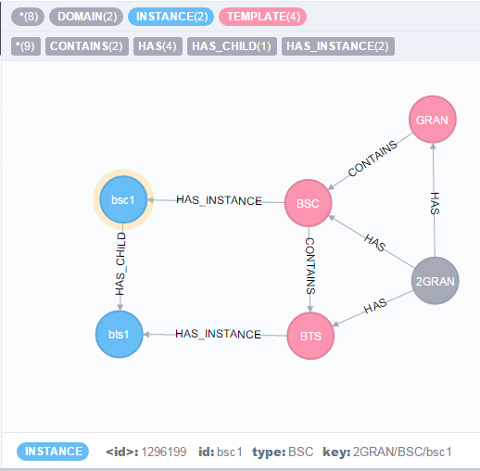
Inventory Instances
After modelling, the collectors response to inject inventory to the DB and bind them to the predefined object.

Slide 9
KPI Definition
KPI/Counter are defined and stored as KPI Definitions and KPI Instances.
All KPI definitions are bind to one model object.
Each KPI definition has one unique ID, the ID is managed by the OSSP console module.
Raw KPI definitions can be created in the GUI of OSSP console or by collectors.
Calculation or aggregation(by NE object or Time) KPIs are defined in the GUI of OSSP console.
New KPI can use existing KPIs (filter by the new KPI’s type and binding Object), no matter the type of the existing KPIs.
KPI instances are created by the collectors, but the system only store raw counters/KPIs. The calculated/aggregated KPIs are not stored in the DB.

Slide 10
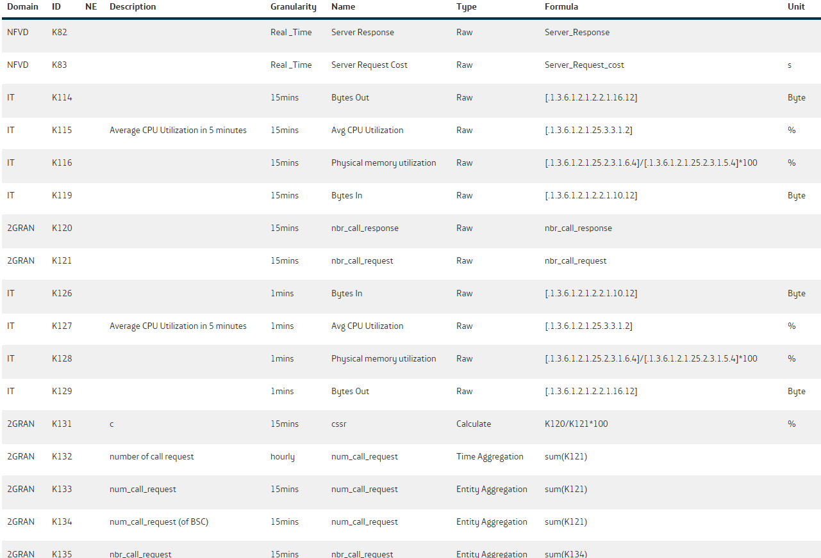
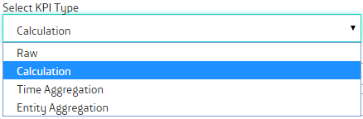
KPI Definition Management GUI -- create and manage KPI definitions
Each KPI has a unique ID assigned by the system.
There are 4 types of KPI
Raw: collect by the collectors.
Calculation: The KPI is calculated based on the KPIs of the same NE and have the same granularity.
Time Aggregation: The KPI is aggregated by the KPI of the same NE type but from smaller granularity.
Entity Aggregation: The KPI is aggregated by the KPI of the sub NE (defined in the model) and have same granularity.
These 4 types shall meet all the KPI requirements, but we still able to enhance it to simplify the types and support more complex formula and support more aggregation functions.

Slide 11
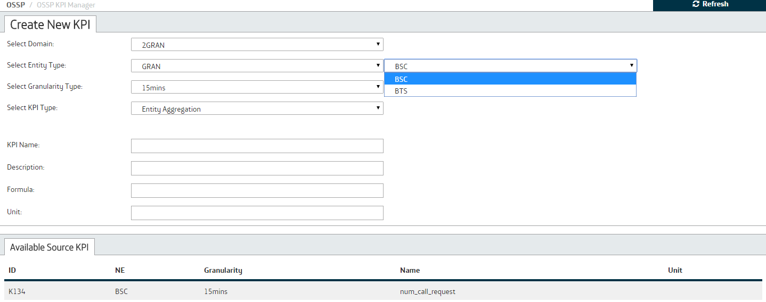
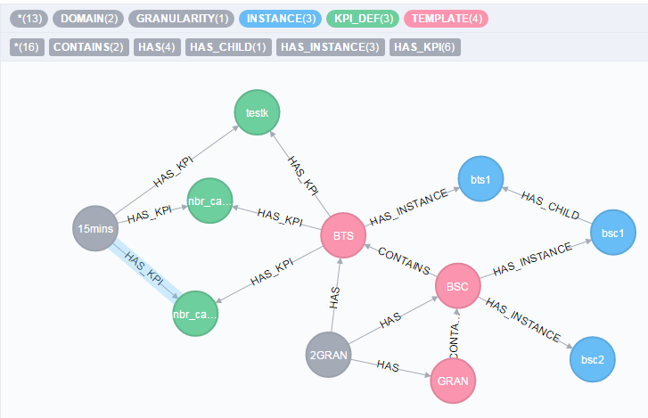
KPI Definition in Database
Each KPI_DEF node must connect to one NE template node and one Granularity definition node.

Slide 12
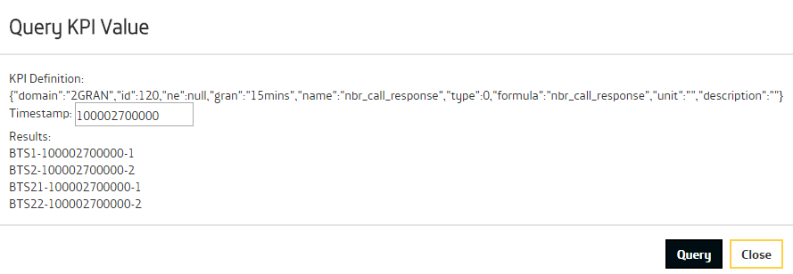
KPI Engine
KPI Engine module is the most valuable module in the system which reflects most important design ideas.
One idea is only store RAW counters/KPIs in the DB, all other KPIs are calculate in runtime. It’s because of in PM collection, the collection and aggregation are running in schedule, while some raw data may comes later, so the aggregation data may not accurate, it’s difficult to update these data. While calculate in runtime is the other side of devil which may encounter performance issue. So current design and prototype may not suit for the real time scenario with lots calculations.
A third part library is included to pares and calculate the Calculation KPI( also used by Threshold module and SNMP collector)
Only support follow aggregation method: sum, avg, max, min and count. (in SNMP collector support these methods and one more: delta)
* The engine provide customized APIs to query KPI values

Slide 13
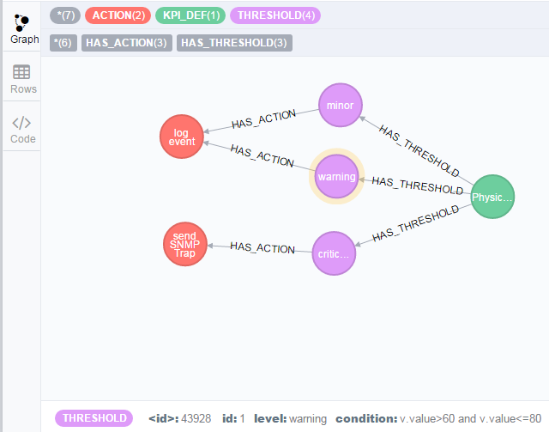
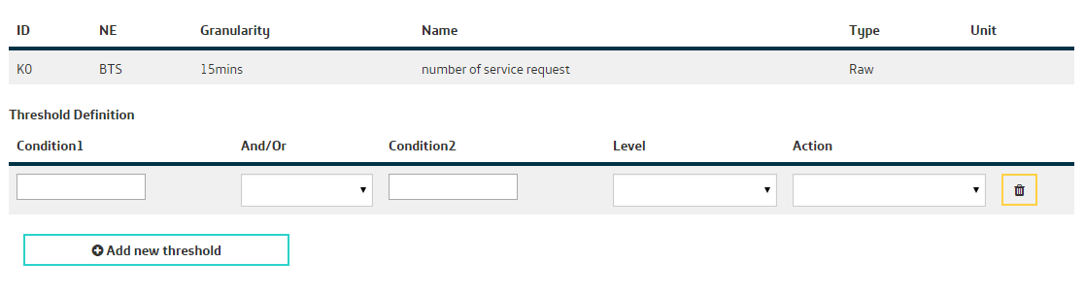
Threshold Management
Each KPI Definition has one or more Threshold definitions.
Each definition has one condition and a Action
The Condition must be a logical expression.
The Action could be various types, but the action module is not develop in the prototype.
Threshold engine will get the KPI values (get from DB if the KPI type is Raw or invoke KPI engine to calculate the KPI values) and check if it’s broke the condition.
The threshold engine shall be invoke by a Job system which is not in the prototype.

Slide 14
Collectors
Most collectors are customized according to real requirements.
The collectors can collect data from all kinds of system/devices in theory.
All collector shall implement a rest interface to manage (start/stop) and monitor (report status) itself.
The collector can be develop in different languages – JS, JAVA, SCALA …
OSSP Console provide a REST API to register new KPI.
Different type collectors can share one REST server, while same type collector must running in different REST servers

Slide 15
Standard CSV Collector
The collector will monitor a configuration directory and consumes new files in configured interval.
The file must in a pre-define format.
The file must have headers.
After collect successfully, the file will be renamed or removed.
KPI must be defined before collecting
Inventory data may come together with performance file or need another collector to collect from inventory system.
Nodes instances are injected using NEO4J merge while for the performance concerns, KPI instances are injected using NEE4J Create and the whole file will be committed as a single transaction. The side effect of it is if there is one KPI instance is duplicated in the DB the whole KPIs in the file are rejected.
<Parent Type> | <Ne Type> | Timestamp | Granularity | <KPI Name1> | <KPI Name2> | …
BSC1 | BTS1 | 148237847383 | 500 | 348 | NA | …

Slide 16
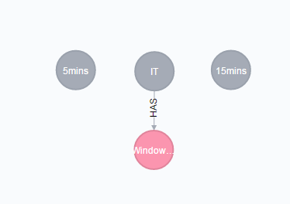
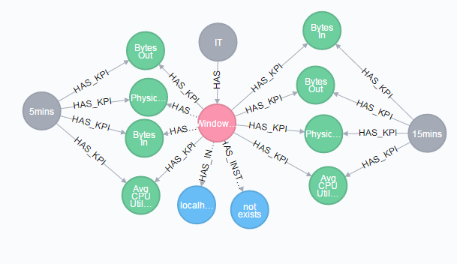
SNMP Collector
SNMP is one of most common protocol to collect performance data. OSSP provide a simple SNMP collector. To implement complex SNMP collection can use NMMI and an collector to collect data from it.
The collector support snmpget and snmpwalk.
The SNMP collector has a configuration file which define the host and collection OIDs.
Different with CSV collector:
The KPI could be calculated or aggregated before ingestion.
"device_info": { "type": "Windows_Host", "name": "localhost", "IP": "127.0.0.1", "community": "public", "version": "2c" }, "OIDs": [ { "method": "get", "name": "Physical memory utilization", "formula": "[.1.3.6.1.2.1.25.2.3.1.6.4]/[.1.3.6.1.2.1.25.2.3.1.5.4]*100", "unit":"%", "interval": 300 }, { "method": "walk", "aggregation": "avg", "name": "Avg CPU Utilization", "formula": "[.1.3.6.1.2.1.25.3.3.1.2]", "description": " Average CPU Utilization in 5 minutes", "unit":"%", "interval": 300 },
Collector initialization

Slide 17
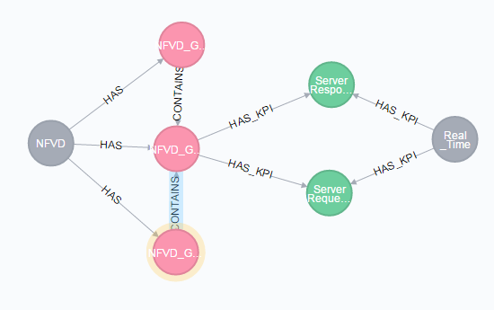
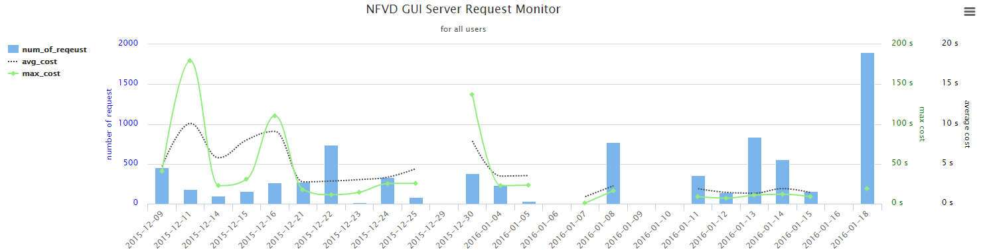
NFVD GUI Log Collector
It’s a high customized collector to collect log files from NFVD GUI
It will help to monitor the communications between GUI server and FF/AA server.

Slide 18
VDC/VAPP Performance Monitoring
Provide Performance reports on VDC, VAPP, VM
VAPP
VM1
CPU:
Memory:
Disk:
VM2
…

Slide 19
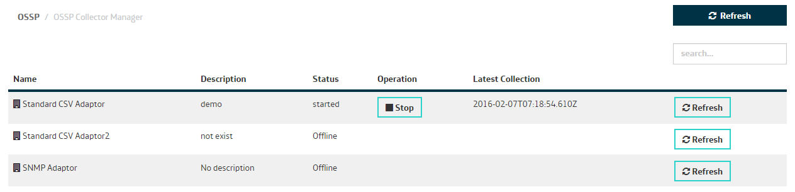
Collector Manager
All collectors defined in a configuration file of OSSP Console.
In the OSSP Collector workspace, we can manage these collectors
[ {"id":0, "type":"csv","name":"Standard CSV Adaptor","desc":"demo", "url":"localhost:3001"}, {"id":1, "type":"csv","name":"Standard CSV Adaptor2","desc":"not exist", "url":"localhost:3002"}, {"id":2, "type":"snmp","name":"SNMP Adaptor","desc":"", "url":"localhost:3001"} ]

Slide 20
Demo

Slide 21
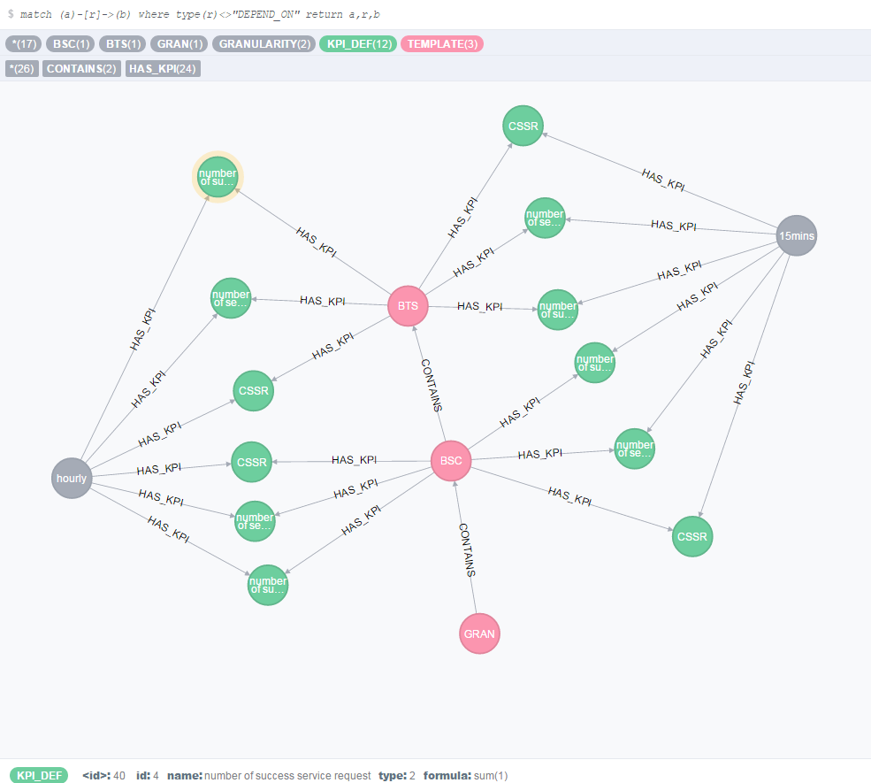
E2E Scenario definitions

Slide 22
Source file
merge (:TEMPLATE:BSC {type:"BSC",desc:""}); merge (:TEMPLATE:BTS {type:"BTS",desc:""});
merge (:KPI_DEF {id:0,name:"number of service request",type:0,formula:"nbr_call_request"});
merge (:KPI_DEF {id:1,name:"number of success service request",type:0,formula:"nbr_call_response"});
BSC,BTS,TS,GRANULARITY,nbr_call_request,nbr_call_response BSC1,BTS1,100000000000,900,1,2 BSC1,BTS1,100000900000,900,1,2 BSC1,BTS1,100001800000,900,1,2 BSC1,BTS1,100002700000,900,1,2 BSC1,BTS2,100000000000,900,1,2 BSC1,BTS2,100000900000,900,1,2 BSC1,BTS2,100001800000,900,1,2 BSC1,BTS2,100002700000,900,1,2
CSV file
merge (:GRANULARITY {id:0,type:"15mins",num:900});

Slide 23
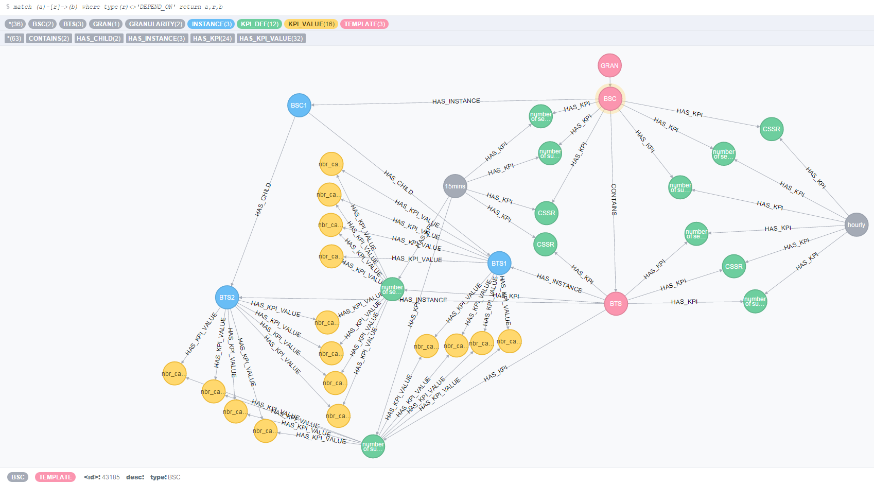
After collect

Slide 24
CSV Collector Performance Test
Test environment:
zbook 15, 8 CPU (i7-4800) ,Memory 32G, OS: windows 7;
Neo4J 2.3.1 community version with default setting
NodeJS v5.2.0
Test 1, simulate one csv file with 10BSC, each BSC has 100 BTS, total 10000 records , each record has 12 KPI value.
Cost 328 seconds
Test 2 simulate 10 csv files, each file has 1BSC 100 BTS 1000 records, each record has 12 KPI value.
Cost 35, 67, 100, 134, 168, 201,235, 302, 339, seconds
It seems the Neo4J is working in serial, 10000 KPIs cost 30 seconds.
Note: 1) During the test, the CPU loading is less than 50% and there is still lots free memory. Also query in the Neo4J console is fast. 2) Need study the configuration of Neo4J.

Slide 25
more
Due to limit of V8(NodeJS) to deal with huge data, it has to split the collector into several collectors work parallel, these collector can run in a distribution environment
Jobs are executed by scheduler. The jobs are:
Calculate/Get KPIs have thresholds
Trigger the actions if thresholds are broken
Data retention
Retention, it’s could calculate the history KPI values (for all types of KPI) into an achieve DB.
Report Packs are not developed in the prototype. UOC or other tools like Pentaho can be used to develop reports. KPI engine will provide APIs to query KPI values

Slide 26
Next Step
Still lots work to make it a real application
Job Management Module
Product level GUI
Algorithm optimize
Merge Entity Aggregation and Time Aggregation
Translate all formula on RAW counters
Retention
Log System
…

